Slide 1
CS Presentation
By: Azeez, Biyi, Sekou

Slide 2
Challenges we faced
Meeting - We all had very different schedules, and so meeting was difficult because to come together as a group we had to look really look hard to find good times that worked for all of us.
Managing the system design document - There was lots of content to keep track of in it, so the system design document had a tendency to get disorganized, or have outdated information.
Aiming the robot - Aiming the robot was more of a challenge then making the block code. If the angle of the aim were barely off then the entire test result would be massively skewed. For the earlier sprints while getting the hang of the aim, we found that we had to place more focus on the aim rather than the actual block code.

Slide 3
Group Roles
Sekou - lead data manager / data recorder - Sekou managed the bulk of the system design document, and recorded down all our groups ideas for different things like the requirements table, the project dependencies, etc. Manager for the system design document. Sekou was also the data recorder for our testing table.
Biyi - assistant data tester / data recorder / robot recorder - Biyi did lots of general work. His role was conditional and did whichever work was most demanding at the time. He assisted Azeez with testing, coming up block code fixes, and also helped Sekou complete some areas of the system design document, and made sure there were no writing errors. He recorded robot videos.
Azeez - lead programmer / tester / supervisor - Azeez programmed all the block code, and lead the robot testing, constantly adjusting the code according to test results.

Slide 4
What we learned
Time Management – We all had very busy schedules, so we had to manage what time we had together effectively. We also had deadlines to meet, so we had to make sure to get all our work in before those deadlines. Also our robot always died quickly, so when we worked we had to work under the assumption that our robot wouldn’t last long. Under such time constraints, we learned to work faster and efficiently.
Problem Solving - We learned problem solving because while trying to get robot to go over the course. We had to constantly deal with problems depending on the sprint. For each of these problems, we had to solve them by identifying the problem, then coming up with solutions. We learned to adopt a trial and error approach throughout the project.
Teamwork – This was a really big project so we really had to learn to work together to get work done. We gradually learned to coordinate better, and everyone fell into their roles nicely. We also learned to communicate our ideas to one another through group discussions.

Slide 5
Things to differently for next time
We should be more careful and check the rubric before submitting our finished assignment. On the first sprint, our group missed some required documents in the github repository so we didn’t fulfill the project criteria.
Make sure the Sphero Robot is completely charged each time before testing - lots of times we had a plans to test and complete the robot video, and then not being able to finish because of the robot dying during testing.
We should make sure to record more videos, because lots of times while we were just testing for results we actually could’ve gotten a good video, but didn’t because we didn’t expect it to go the entire course.

Slide 6
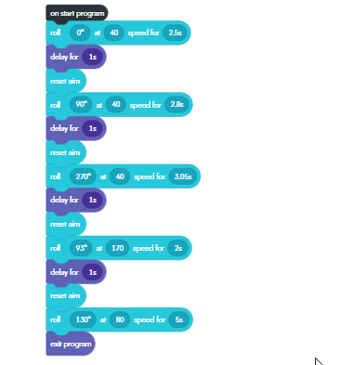
Block Code
We had the robot roll at a slow speed, and added a
delay so it would accurately roll around the
obstacles without skidding off target.
Then we had it change to a higher speed so it had enough
momentum to roll over the ramp. Then switched it
back to a moderate speed and rolled it at the pins.

Slide 7
